Slide 1
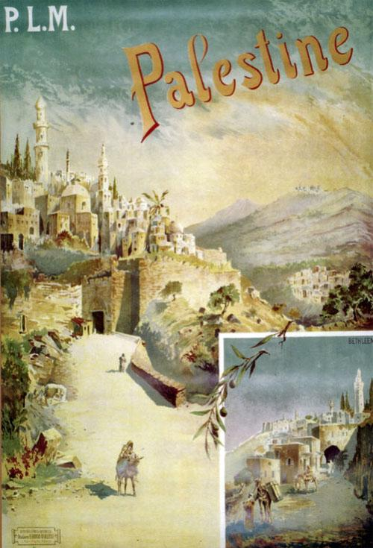
100 years of Colonization, dehumanization, ethnic cleansing, erasure of the Palestinian people
100 years of resilience and resistance by the palestinan people
Bassam Hussein
Professor NTNU
Louis Guerry 1898

Slide 2
Contents
Colonization of Palestine ---- A brief Chronology
  Context, western complicity and Zionism
Dehumanization of the indigenous Palestinian people
  Main practice for colonization (erasure, expulsion, ethnic cleansing, culturicide and genocide)
Resilience, Resistance and Decolonization. More than ½ million Palestinians are killed since 1920 in the fight for freedom and decolonization.

Slide 3
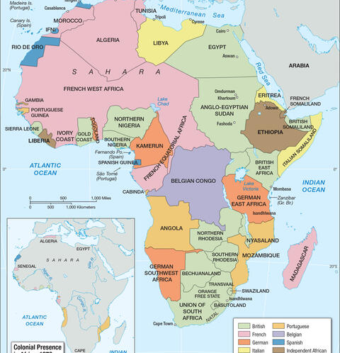
Context
Israel as a settler colonial project was conceived as early as 1799 and it is a part of a many colonization attempts in many parts of the world.
Between 1885 and 1914, Britain controlled nearly 30% of Africa's population

Slide 4
Western complicity
This project would have never existed without the continues complicity of imperial powers
A colonial structure that persists to this day in the West.
The West portray Isreal within the framework of Western democratic tradition. Legitimizing its actions as self-defense
Zionists web of power has become an integral part of the political and economic landscape in the West

Slide 5
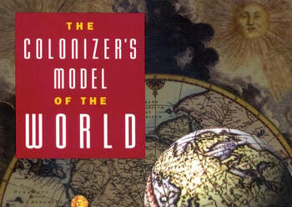
What drives colonization?
The Basic Racist Argument
  The colonizers have unique qualities of race, environment, culture and mindsett that must be diffused to the rest of the world and 2) must replace the environment, mindsett, culture and of the “others

Slide 6
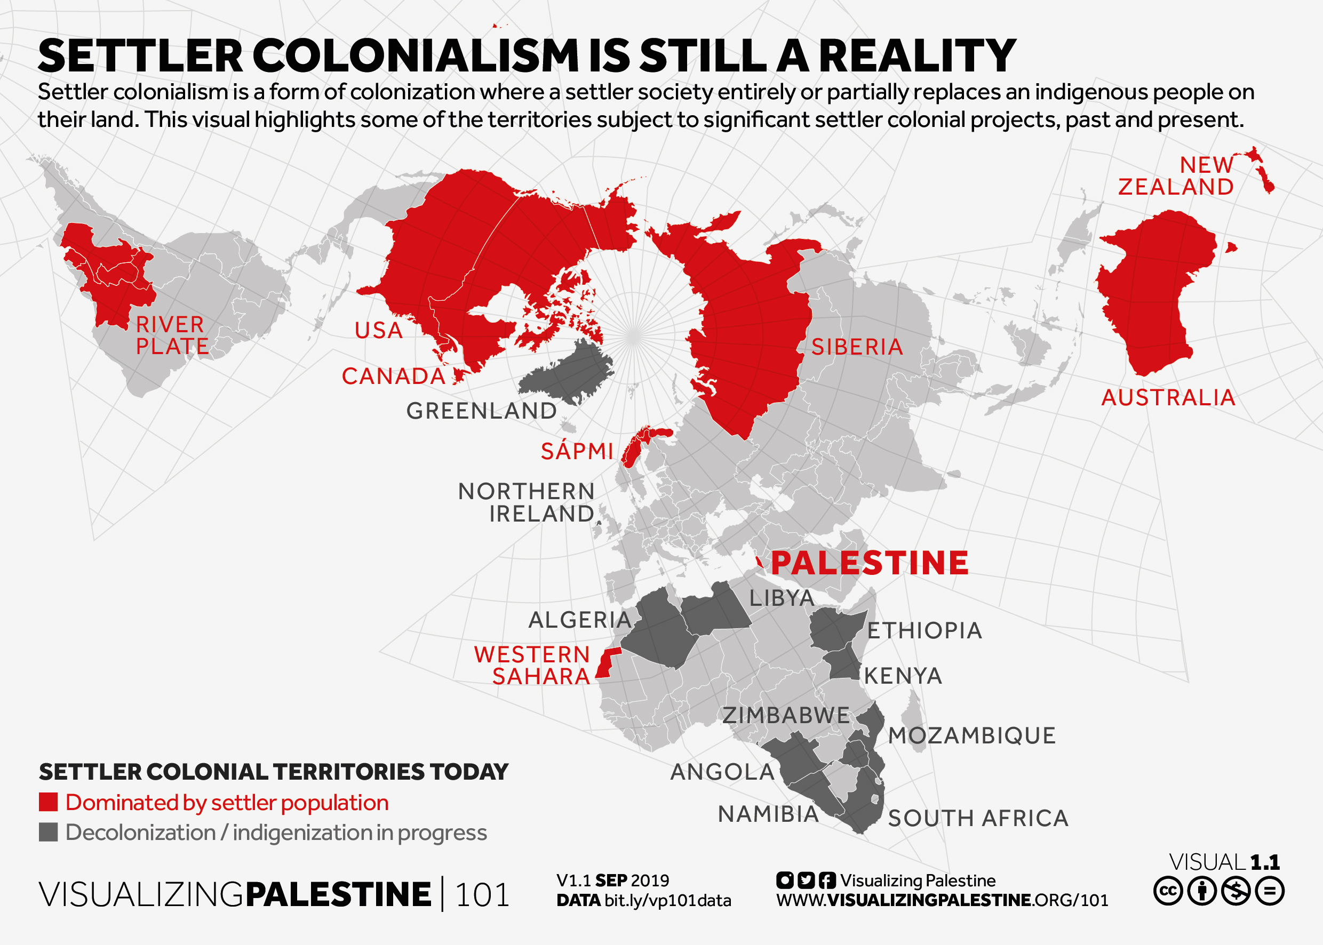
Colonization
Classical Colonialism
  Exploiting
Settler-Colonialism (on going structure)
  Dehumanization
  Physical elimination
  Expelling
  Isolation
  Forced Inter-breeding
  Forced religious conversion
https://101.visualizingpalestine.org/visuals/settler-colonialism-still-reality

Slide 7
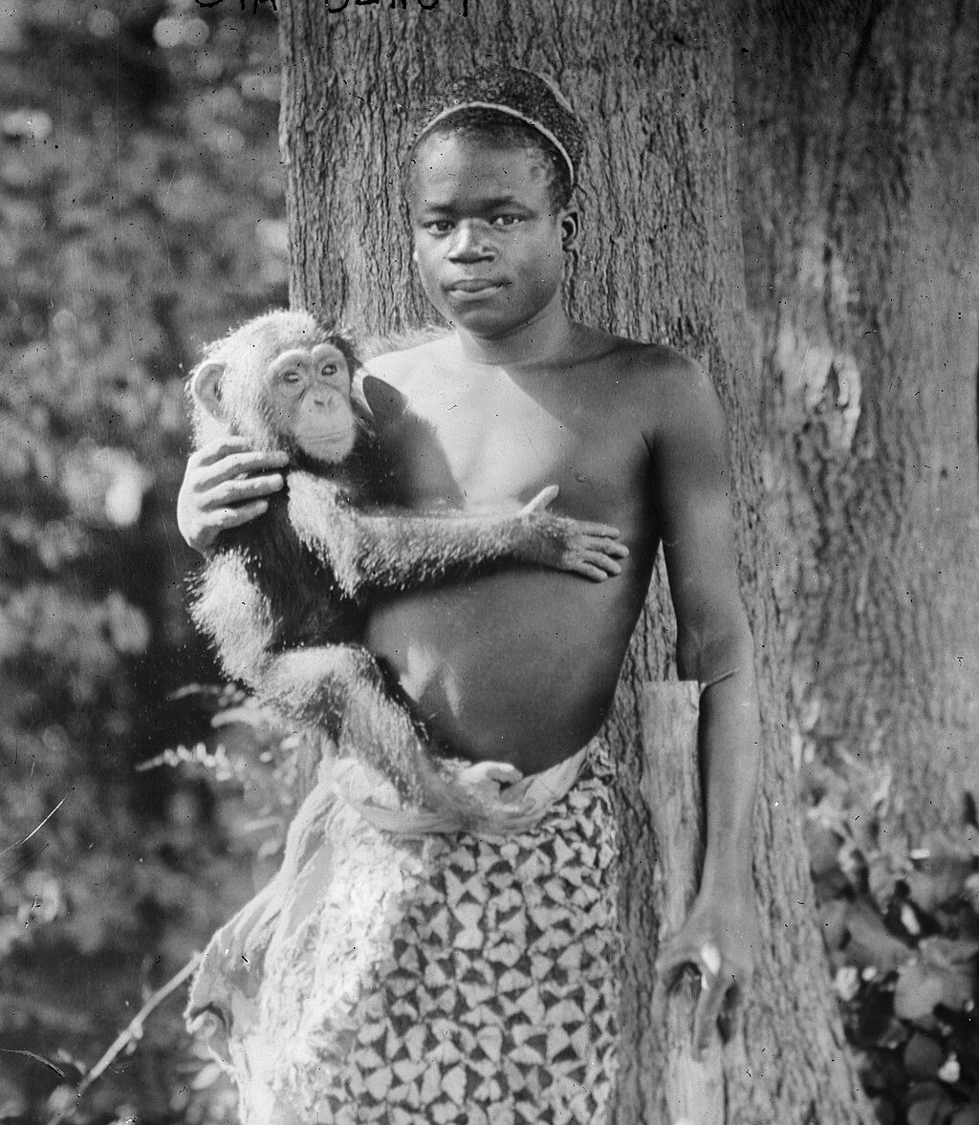
Dehumanization: most effective weapon because it normalizes pain, atrocity and suffering .
Ota Benga from Congo,
He was put in zoo and was presented as a "living proof" of Darwinist theories of human evolution.
In 1906, Ota Benga was placed in the Bronx Zoo in New York, where he was displayed in a cage with monkeys

Slide 8
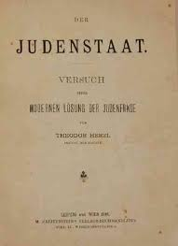
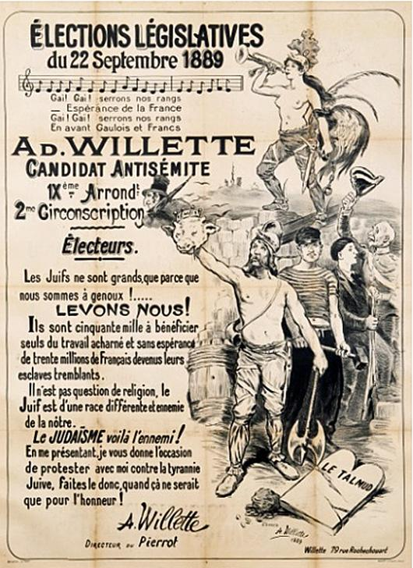
A brief Chronology of Palestine Colonization
1799- The idea of establishing a Jewish protectorate in Palestine was first proposed by Napoleon.
1880-1900 Antisemitic sentiment and attacks on jews in Europe
Between 1882 and 1903, 25,000 European Jews, mainly from Eastern Europe, emigrate to Palestine funded by wealthy jews (Rothchild)
1895 Theodor Herzl , an Austrian journalist, publishes Der Judenstaat (The Jewish State) where he advocates the establishment of a Jewish state in Palestine or elsewhere as the solution to the "Jewish question"
1897 First Zionist Congress
1917 Balfour Declaration
1920-1946 Massive Jewish immigration to Palestine (374 000 jews ) under British mandate
1947 Partition plan (55% to jews who owned 6% of arable land and 45% to Palestinians who owns 94% of the land)
Plan D April 1948: 120,000 Israeli soldiers attacked 220 Palestinian towns and villages expelling more than 400 000 Palestinians from their towns
1948 Nakba (all together 900 000 Palestinians were expelled and around 500 villages were ethnically cleansed)
1967 Naksa war (occupation of West-Bank and Gaza)
1993-2023 Oslo Accords: Colonization of the west bank 700 000 new colonizers
2023 Alaqsa flood and the masks off

Slide 9
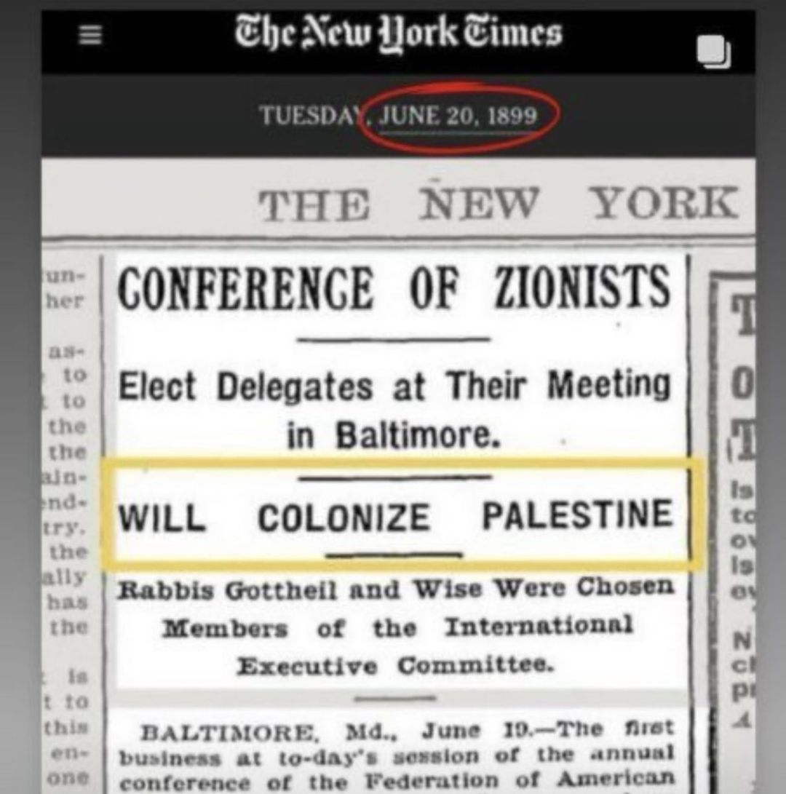
Zionism and its relation to colonialism
Vladimir Jabotinsky and Theodor Herzl, described Zionism as a form of colonialism
Jewish Colonization Association (still active but changed its name to Jewish Charitable Association (ICA).)
Edward Said, Ilan Pappe, Noam Chomsky: Israel's foundation and continued existence are rooted in colonial practices.

Slide 10
Dehumanization in case of Palestine
Total denial of Palestinian existence
Systematic Erasure of Palestinian culture (culturalcide)
  Robbed properties, land and food, renaming cities and villages and streets
Calling the Palestinians destructive elements, terrorists and then human animals
Creating physical, legal and time barriers between Palestinian communities to prevent developing cultural and physical bonds.

Slide 11
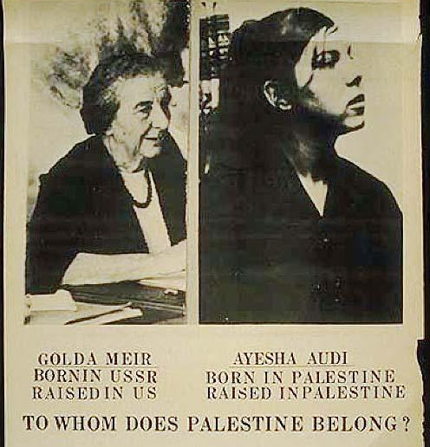
Errasure
The colonizers engaged in a systematic effort to erase the Palestinian people from the narrative entirely, claiming that we did not exist.
In public, Zionist leaders have used typical colonial termonolgy claiming that Palestine was empty:
  Uninhabited
  virgin territory
  terra nullius,
“It was not as if there was a Palestinian people in Palestine and we came and threw them out and took their country away from them. They did not exist.” Golda Meir

Slide 12
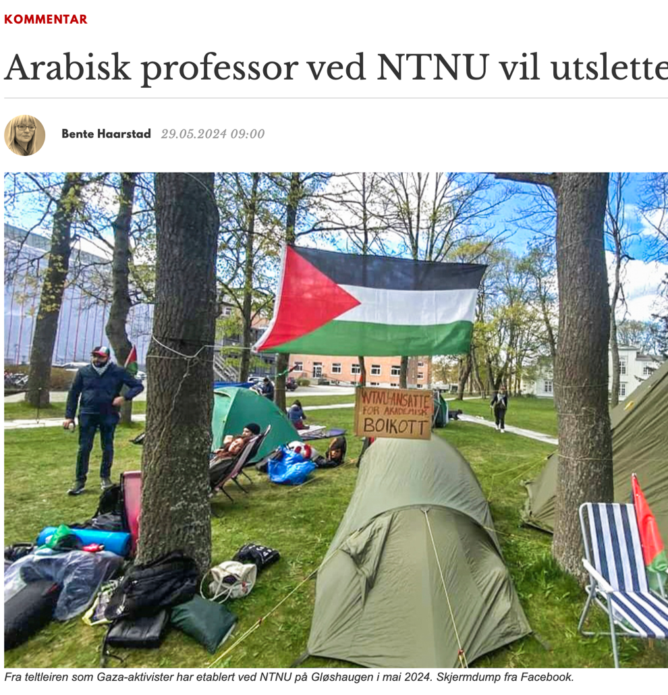
Replace the word Palestinian with Palestine-Arabs
They refuse to use the word Palestinians to refer to the Arab population of historical Palestine.
Even the Zionist supporters in the West continue to refuse to use the word Palestinian when they refer to any Palestinian. See the screen dump.

Slide 13
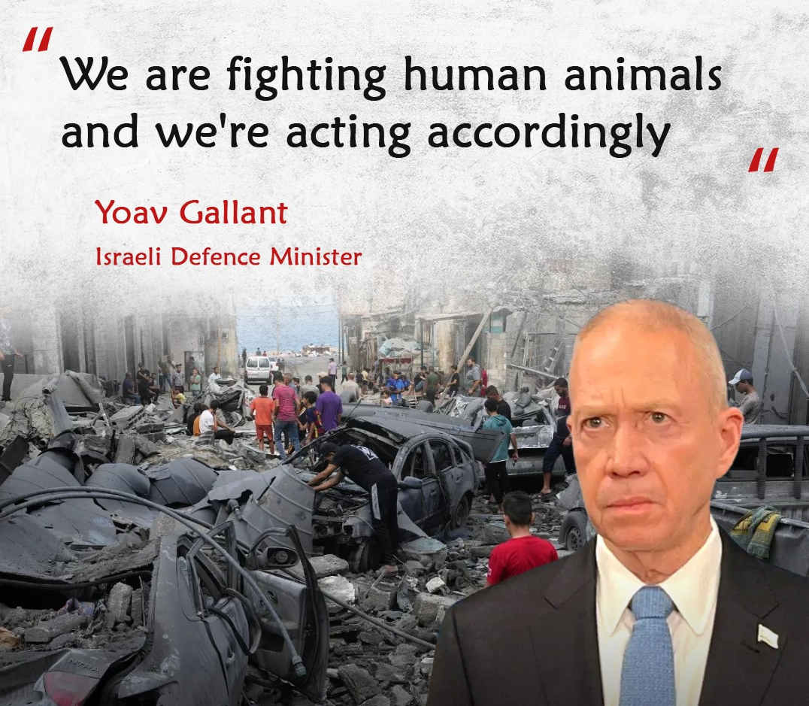
Calling Palestinians as destroyers, terrorists or animals
When the Palestinians resisted:
Israel labeled the Palestinians destroyers
As resistance continued, Palestinians were then branded as "terrorists,"
Then "animals," a term that strips Palestinians of their humanity entirely.

Slide 14
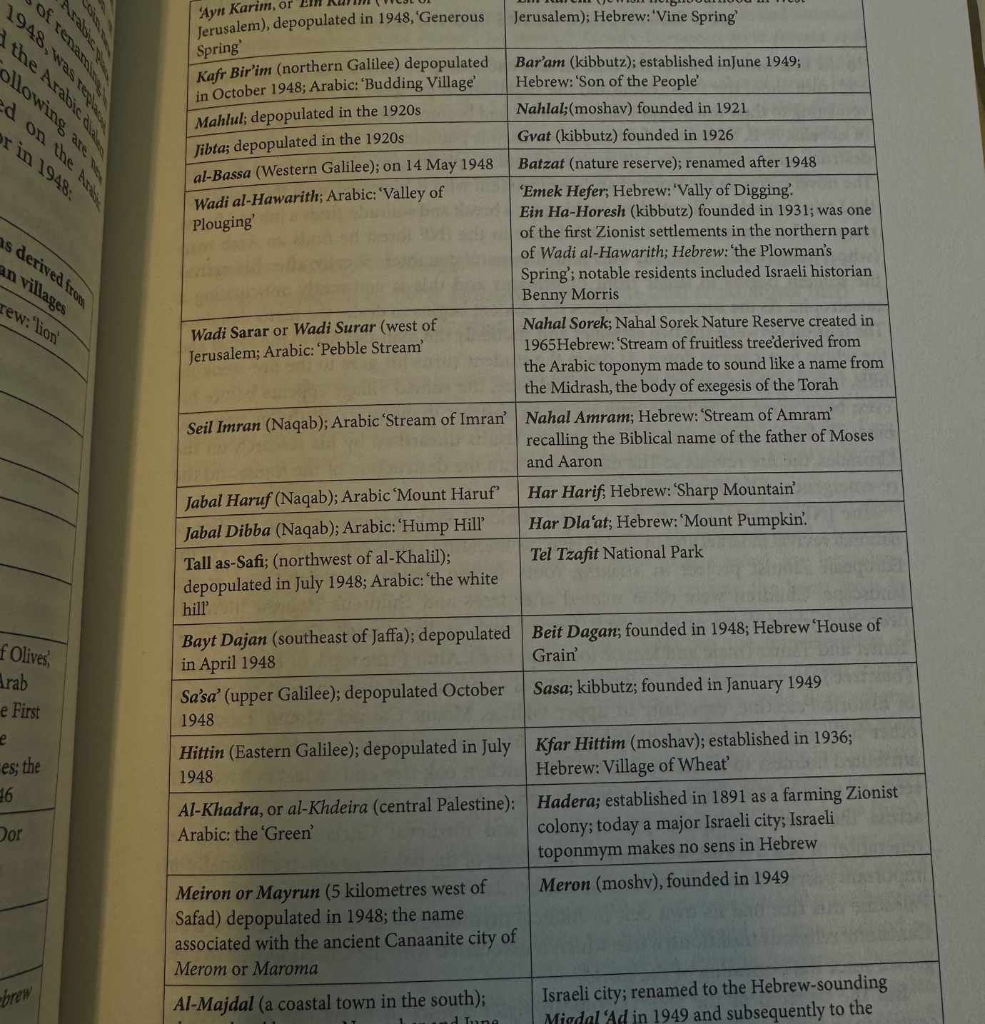
Renaming of Palestinian cities and villages
The erasure of Arab place names and their replacement with Hebrew names began as early as the 1920s, during the British Mandate. A naming committee was established for this purpose
Prime Minister David Ben-Gurion outlined the committee's objectives in a letter to its chairman:
"We are obligated to remove the Arabic names for state-related reasons. Just as we do not recognize the Arabs' political ownership of the land, we do not recognize their spiritual ownership and their names."
In the Negev, 333 out of the 533 new names decided by the committee were either phonetic translations or similar to the Arabic names.

Slide 15
Other Practice of the culturalcide in Palestine
Time:
  Physical barriers, and bureaucratic processes that drain Palestinians' time, limiting their freedom of movement and ability to thrive economically and culturally
Family
  Imposing barriers that prevent or severely limit Palestinians from maintaining close ties with their relatives or spouses, both geographically and culturally.

Slide 16
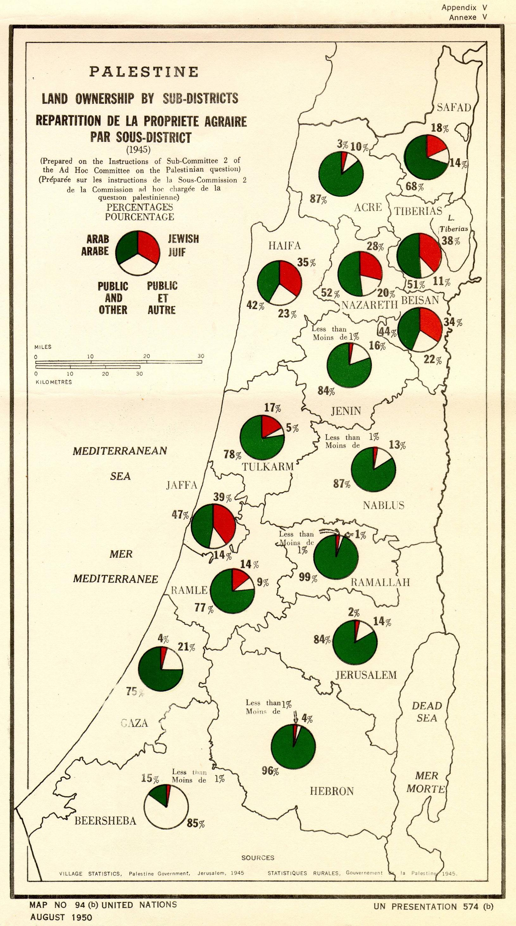
Other Practice of the culturalcide in Palestine
In 1950, Israel enacted the Absentee Property Law, allowing it to confiscate Palestinian properties whose owners were forced to leave in 1948.
Property belonging to absentees was placed under the control of the State of Israel with the Custodian for Absentees’ Property.

Slide 17
Deleting memory
The Nakba Law (2011) strips state funding from any public entity, including educational institutions, that commemorates the Nakba or rejects the existence of Israel as a “Jewish and democratic state”.

Slide 18
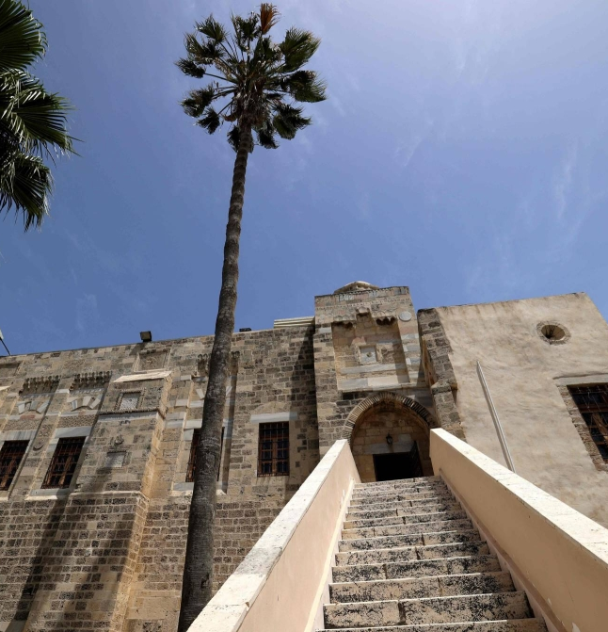
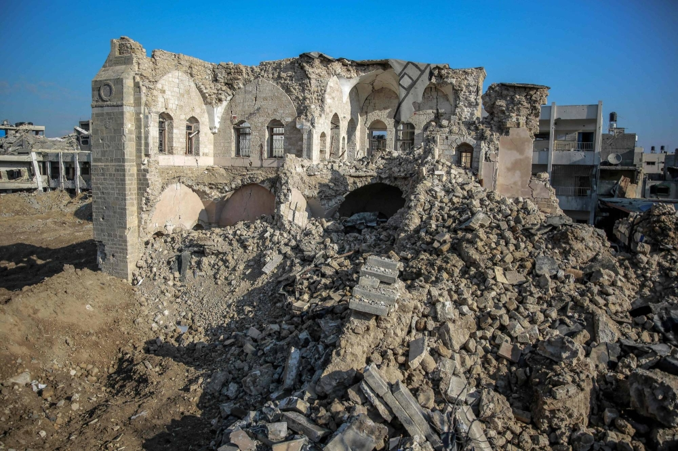
More Evidence of the culturalcide in Palestine
Physical Destruction (in particular during the war on Gaza and Westbank 2023)
  As of February 2024, they report that 44 people involved with arts and culture were killed and around 200 historic buildings were damaged or destroyed, along with 12 museums and numerous cultural centres.

Slide 19
Part 2
Zionism

Slide 20
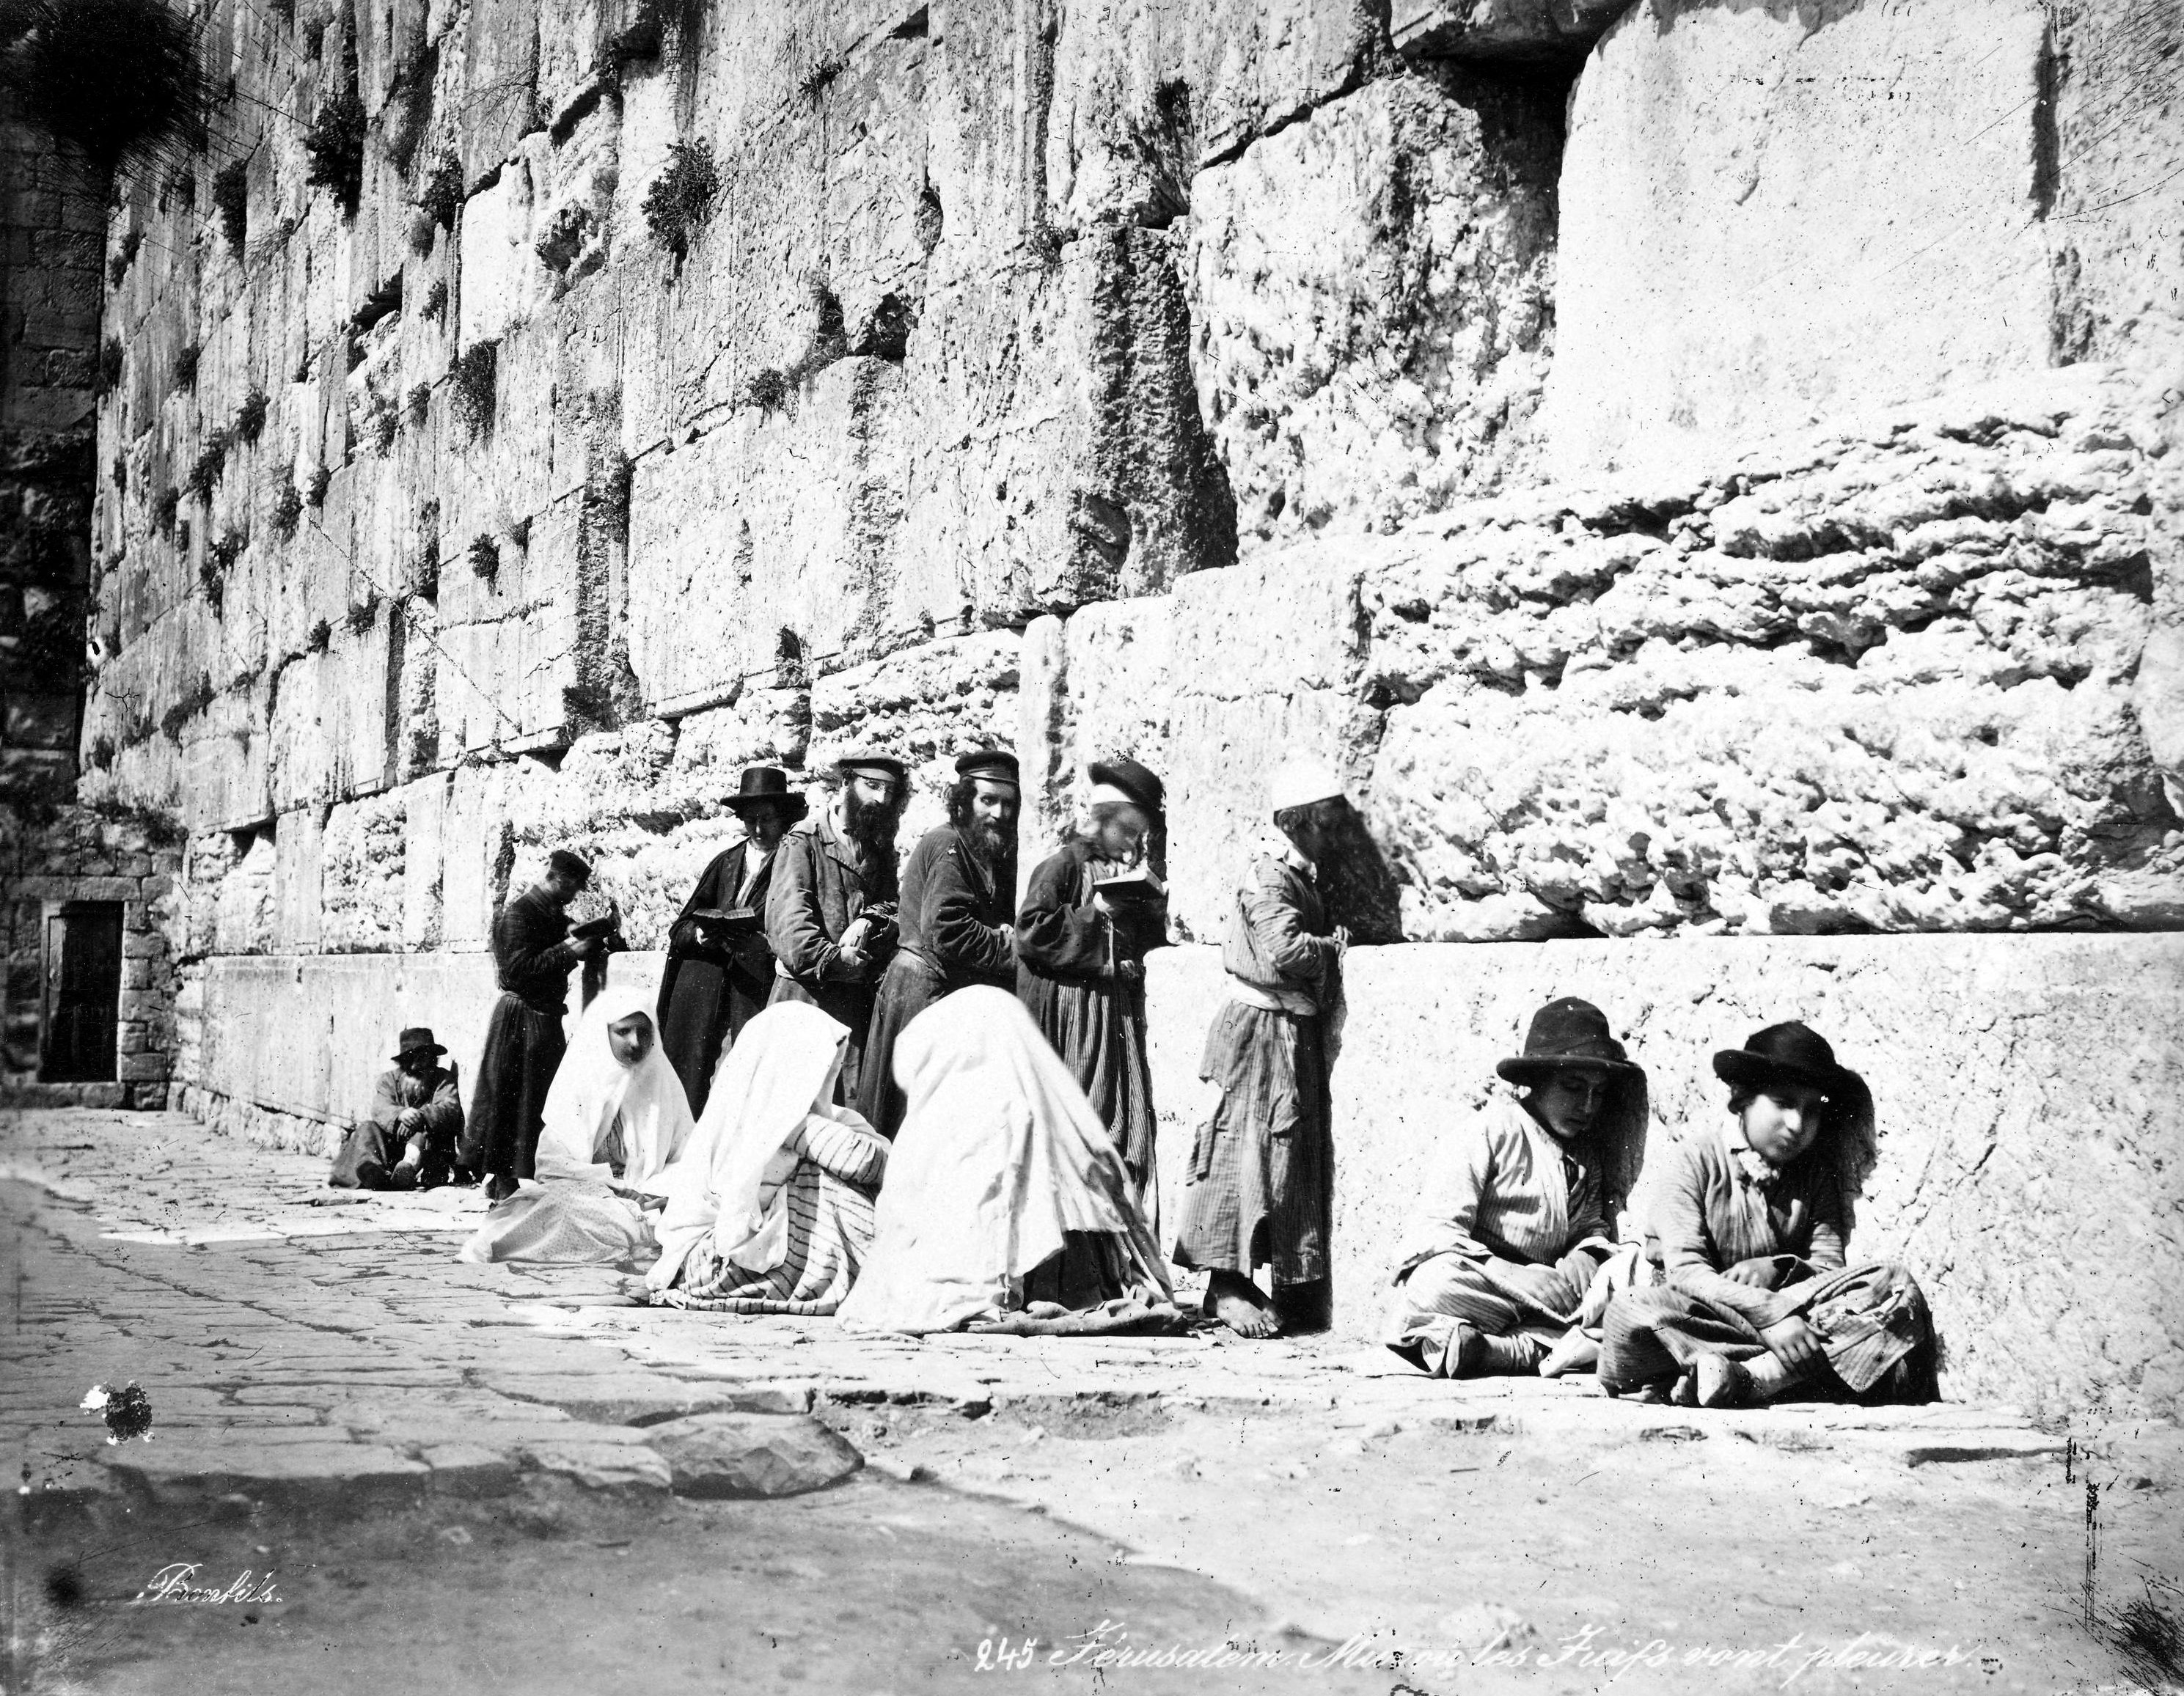
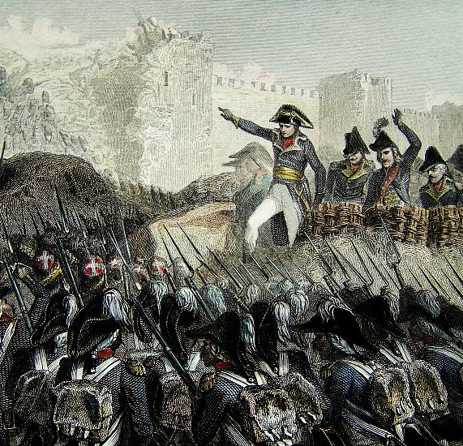
A Chronology of Palestine Colonization
1799 while Palestine was under Othman ules, the idea of establishing a Jewish protectorate in Palestine was first proposed by Napoleon. He suggested forming a Jewish state under French protection.

Slide 21
the Ottoman census of 1878 indicated the following demographics for the Jerusalem, Nablus, and Acre districts
Census Group | Population | Percentage
Muslim | 403,795 | 85.5
Christian | 43,659 | 9.2
Jewish | 15,001 | 3.2
Jewish (Foreign-born) | Est. 10,000 | 2.1
Total: | 472,455 | 100.0

Slide 22
Antisemitic sentiment and attacks on jews in Europe late 1880-1900

Slide 23
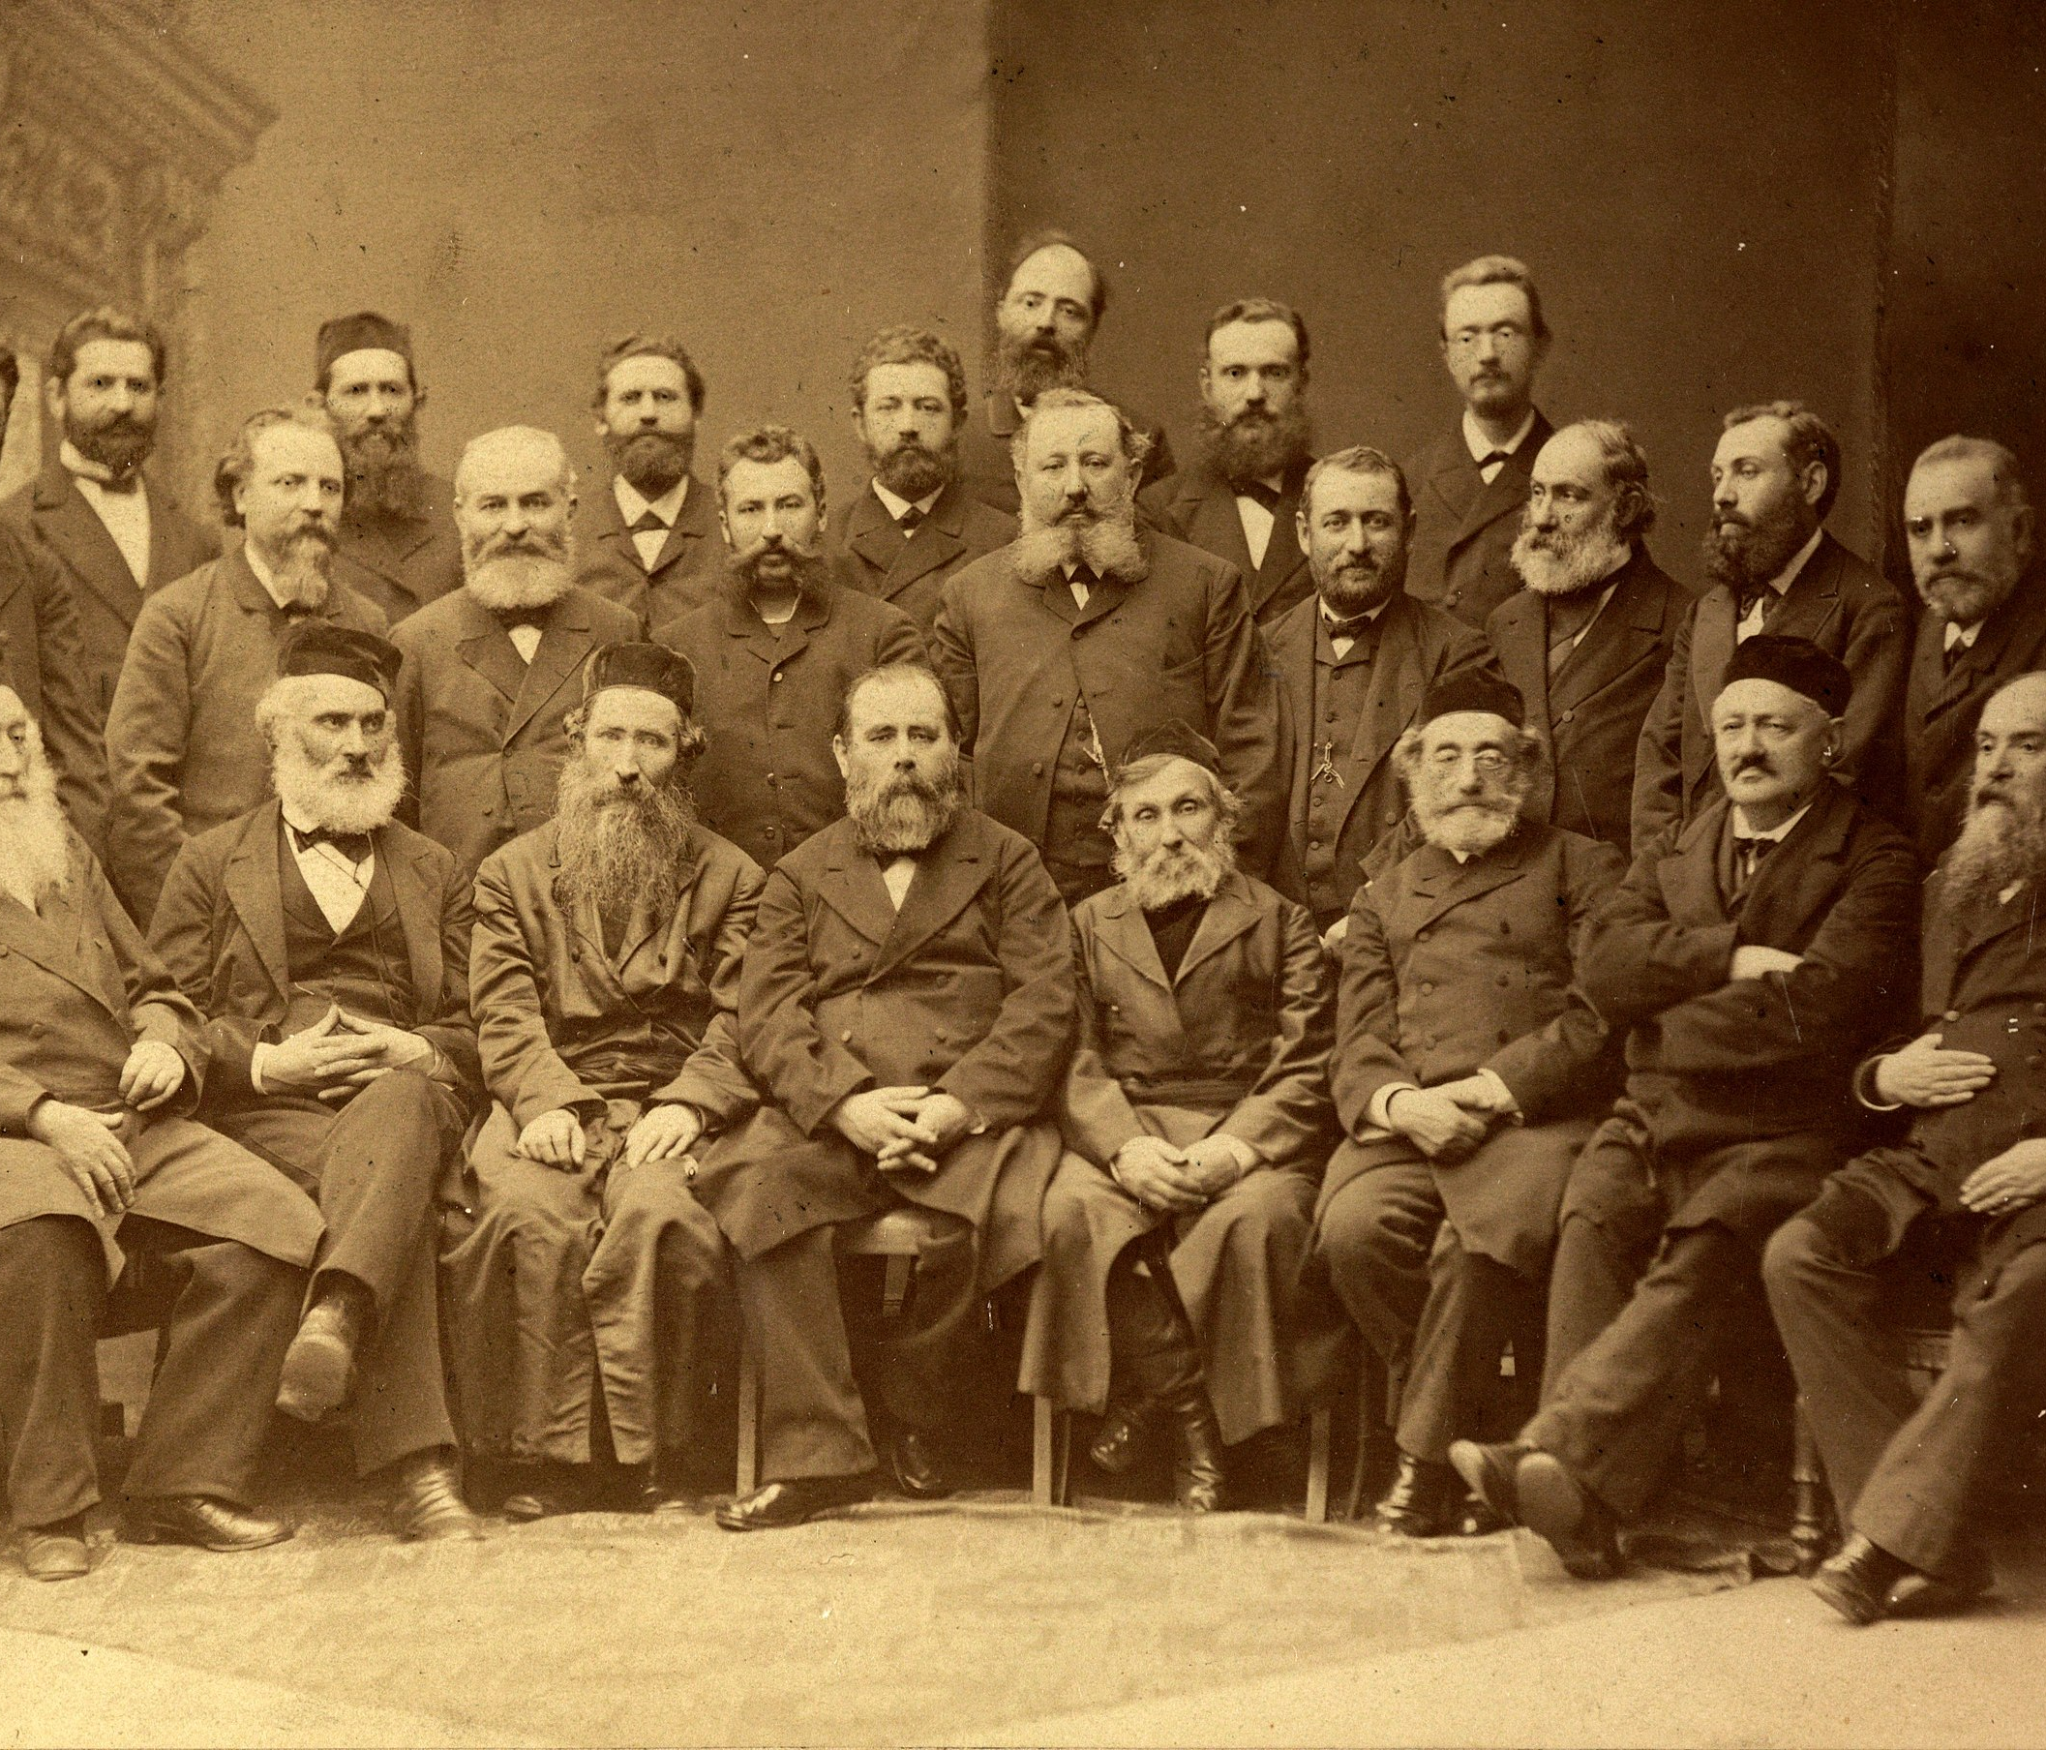
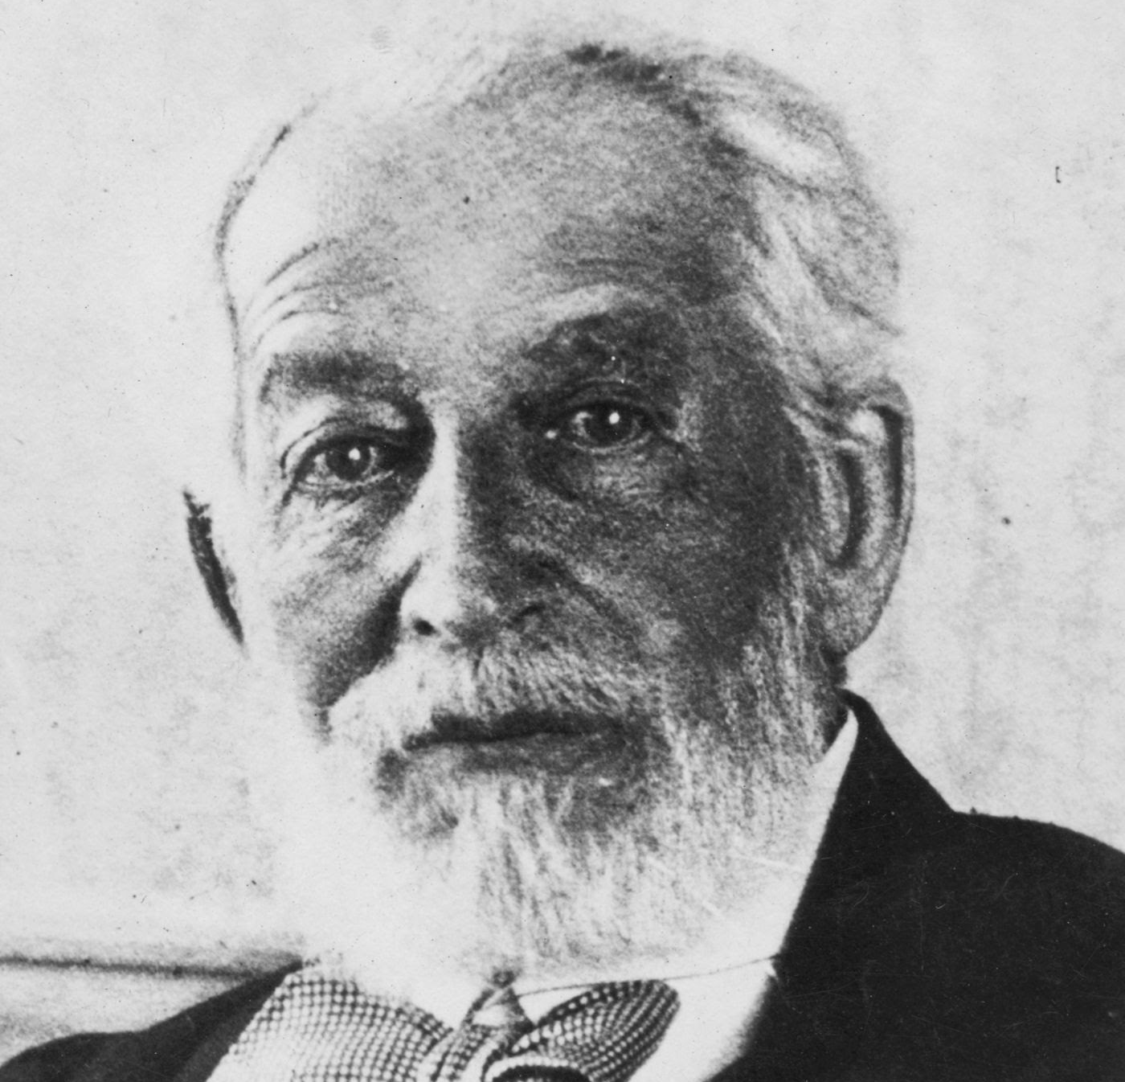
Emergence of Jewish Nationalism movement
1884 Hovevei Zion (Lovers of Zion) groups emerge in Russia and Eastern Europe. They hold their first congress in Kattowitz (now Poland), establish a charity to support Jewish farmers in Syria and Palestine.
Between 1882 and 1903, 25,000 European Jews, mainly from Eastern Europe, emigrate to Palestine. Wealthy European Jews like Baron Edmond de Rothschild invested 14 million francs to establish Jewish colonies in Palestine.
Ottoman rulers attempted to limit Jewish emigration to Palestine but was heavily criticized by European Powers at the Time

Slide 24
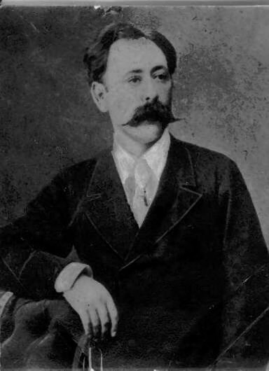
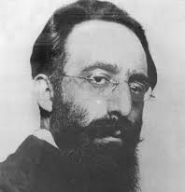
Zionisim
1885 the term Zionism was coined by Austrian Nathan Birnbaum.
  The establishment of a Jewish homeland in Palestine
1891 Establishment of the Jewish Colonization Association (JCA) is founded in London by German Baron Maurice de Hirsch to help “establish [Jewish] colonies in various parts of the Americas and other countries for agricultural, commercial, and other purposes.”
The JCA will start supporting Jewish colonies in Palestine in 1896.

Slide 25
Emergence of Zionist movement
Theodor Herzl , an Austrian journalist, publishes Der Judenstaat (The Jewish State) where he advocates the establishment of a Jewish state in Palestine or elsewhere as the solution to the "Jewish question"
He explains that the state he calls for will "form a portion of a rampart of Europe against Asia, an outpost of civilization as opposed to barbarism." Herzl will be considered the father of modern political Zionism .
In 1897, Herzl organized the First Zionist Congress, which met in Basel, Switzerland. He also formed and became the first president of the World Zionist Organization.

Slide 26
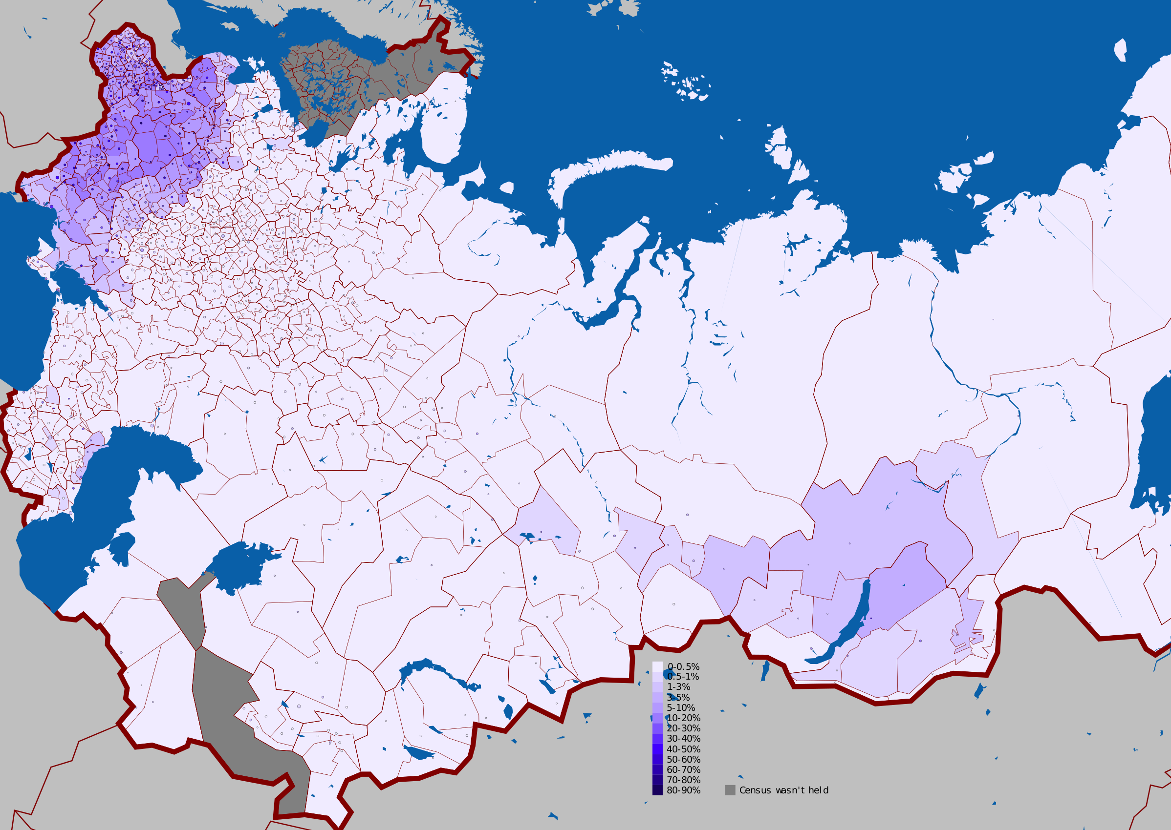
Jewish State
Several countries were proposed for the future state
Max Bodenheimer proposed the Pale of Settlements (Belarus, Moldova, Lithuania, Ukraine, Poland and parts of Latvia)
  Pale meaning an enclosed area.
Uganda (5000 kvm)
Argentina

Slide 27
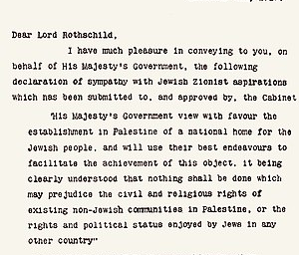
(1918-1947 (Massive Jewish emigration and Colonization)
1917
Balfour Declaration
1918
the number of Jews increased to 50,000 and the Palestinians were at 500,000

Slide 28
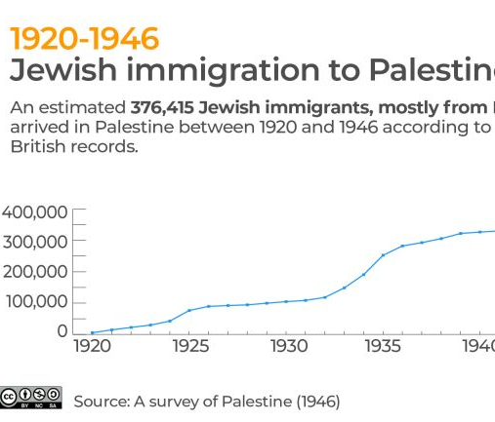
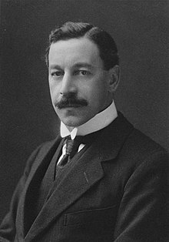
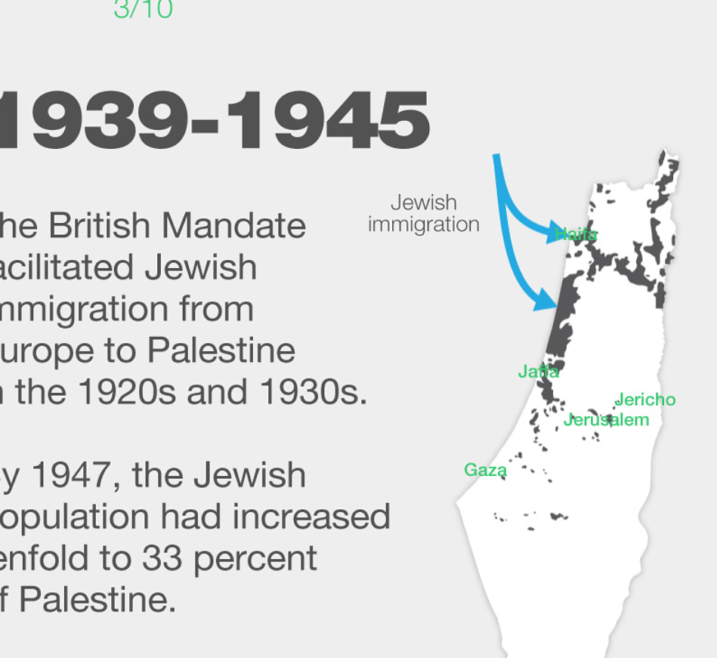
(1918-1947 (Massive Jewish emigration and Colonization)
1920-1936 Herbert British High Commissioner.
Self-declared Zionist. He was responsible for the practical establishment of Israel:
  Laws
  Education
  Army
  Renaming of Palestinian cities and villages

Slide 29

Aiding the colonizer why?
Zionism did not ‘succeed’ because of Jewish support but because of ‘western’ imperial backing, The Zionists cleverly slotted themselves into imperial designs, made themselves useful as tools Britain – in particular – could use in their redesigning of the Middle East. Jeremy Salt
Why?
  Racism
  Solving the Jewish problem in Europe (another racist dimension)
  Christian-Zionism (Colonial interpretation of the bible)

Slide 30

Edward Said on the question of Palestine
Certainly, so far as the West is concerned, Palestine has been a place where a relatively advanced (because European) incom­ing population of Jews has performed miracles of construction and civilizing and has fought brilliantly successful technical wars against what was always portrayed as a dumb, essentially repellent population of uncivilized Arab natives.
  For the West, the battle for Palestine is a battle between "civilized" smart, intelligent white Europeans and backward, stubborn and dirty Arabs.

Slide 31
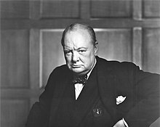
Winston Churchill, 1874-1965, To the Peel Commission on a Jewish Homeland in Palestine, 1937
I do not agree that the dog in a manger has the final right to the manger even though he may have lain there for a very long time. I do not admit that right. I do not admit for instance, that a great wrong has been done to the Red Indians of America or the black people of Australia. I do not admit that a wrong has been done to these people by the fact that a stronger race, a higher-grade race, a more worldly-wise race to put it that way, has come in and taken their place.

Slide 32
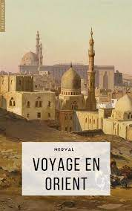
Alphonse de Lamartine
Voyage en Orient. 1833
  The land (Palestine) is essentially empty, it was not a land and therefore a fantastic place for an imperialist or colonial project that France could undertake.
Like all strands of European colonialism, They considered any territory “empty” and available if its people had not achieved statehood.
For them, it was simply a matter of finding this open empty space –In the case of Palestine, it was deemed empty and devoid of culture and the Palestinian people were portrayed as marginal and uncultured.

Slide 33
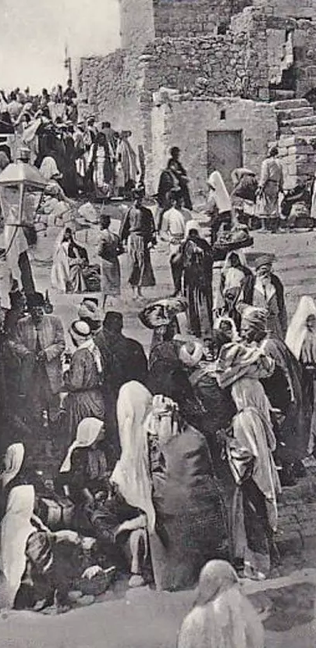
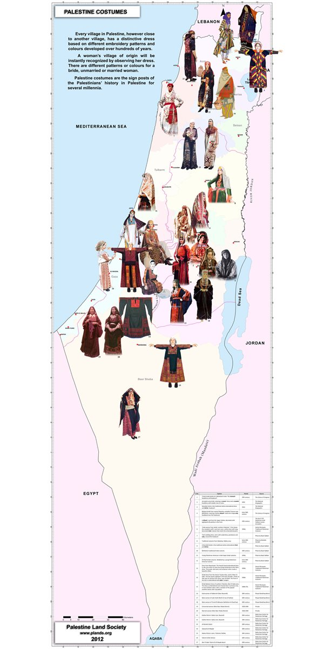
Palestine was not empty
Palestine before 1948. "The bride is beautiful but she is married to another man" – GHADA KARMI

Slide 34

The same mindsett is still dominant
De-humanizing the others
Portraying the world as we- OR them
Putting all the others into boxes
We know better, we are divers, we are knowledgeable, we are smarter, we have values
Then continue stealing the land

Slide 35
A chronology of atrocities and resistance
1920-1935
start of armed Palestinian resistance. Led by Izz al-Din al-Qassam. Al-Qassam was killed by the British in 1935
1936-1939
First Intifada
1947-1949
Start of Nakba 2.0 and partition of Palestine.
1907
Actual implementation of Zionism (taking over the land and expelling locals) 60,000 Palestinian farmers were forced to leave their villages after Baron De Rothschild bought 10,000 dunams in Marj-Bin Aamer. Start Nakba 01
1917
Balfour Declaration: The Balfour Declaration was the promise of those who did not own to those who have no title, giving away the property of the absent lawful owners
1920-1936
Herbert British High Commissioner was appointed. Self-declared Zionist. He was responsible for the practical establishment of Israel. Massive Jewish emigration to Palestine
2023
The Oslo Accords. Nakba 3.0
The prison break. Beginning of End of Nakba
1993

Slide 36
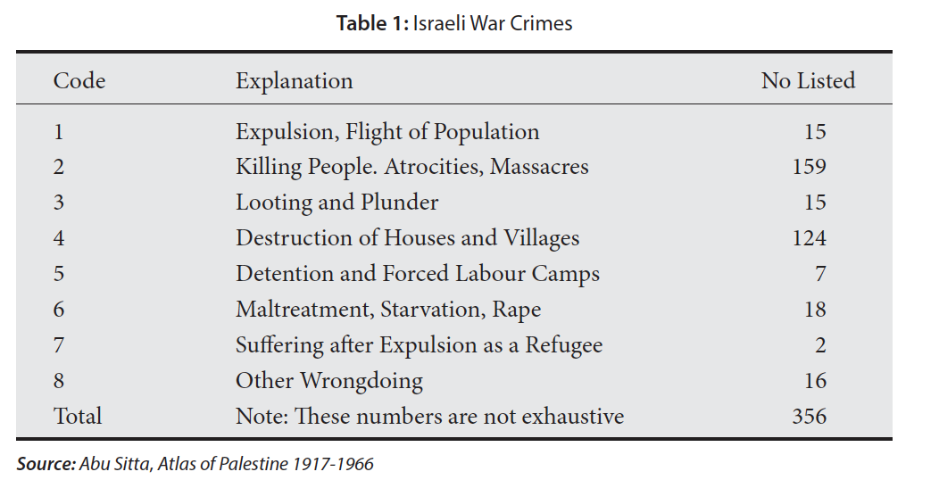
Nakba 2.0
356 war crimes committed by Israel between 1947 and 1953, including 156 massacres and killings of civilians.
A total of 530 towns and villages were ethnically cleansed
900,000 Palestinians were rendered stateless

Slide 37
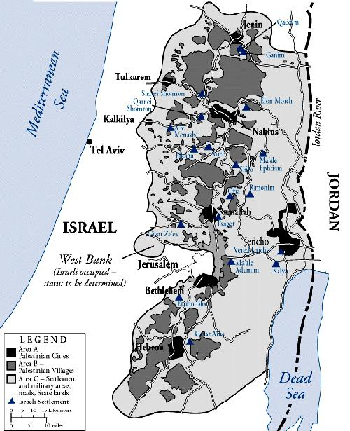
COLONIZATION OF THE WEST-BANK
Oslo agreement
Palestinian forces work to ensure Israeli security in exchange for (self-rule) over 6% of historic Palestine.

Slide 38
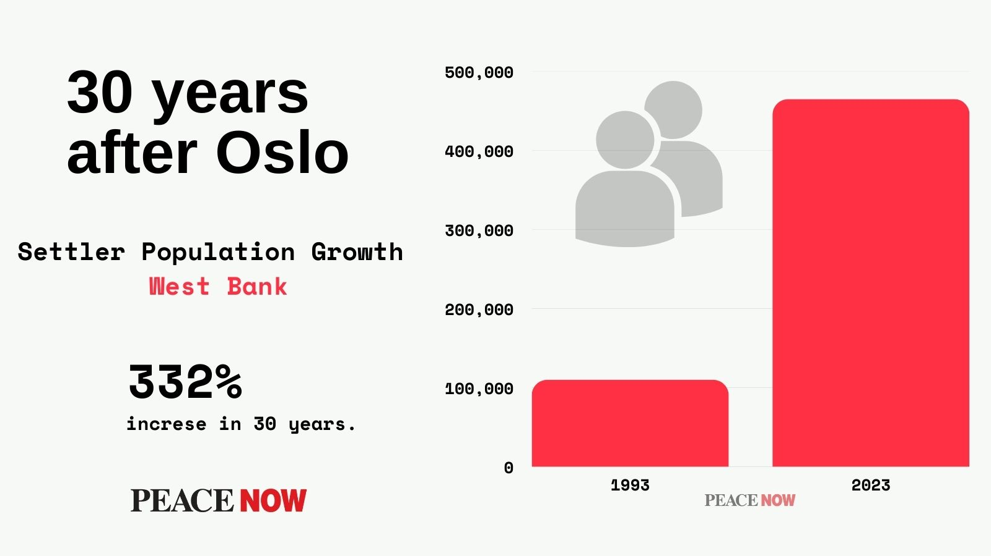

Slide 39
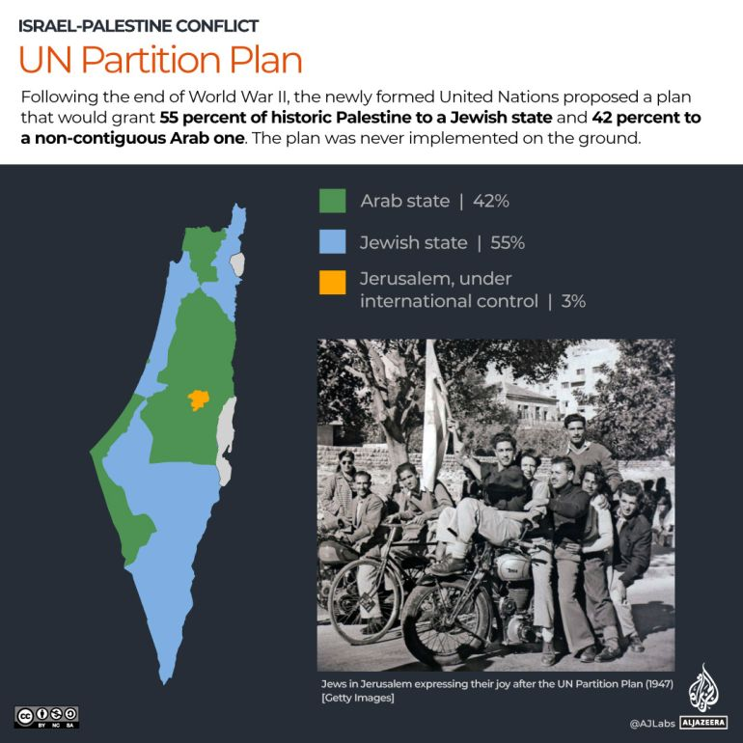
Colonization phase 2:Establishing the state and expelling indegenouis people 1947- 1949
Resolution 181 ( 55% of palestine was given to strangers who made up 335 OF THE POPULATION OF PALESTINE )
33 yes
  Australia, Belgium, Bolivia, Brazil, Byelorussian S.S.R., Canada, Costa Rica, Czechoslovakia, Denmark, Dominican Republic, Ecuador, France, Guatemala, Haiti, Iceland, Liberia, Luxemburg, Netherlands, New Zealand, Nicaragua, Norway, Panama, Paraguay, Peru, Philippines, Poland, Sweden, Ukrainian S.S.R., Union of South Africa, U.S.A., U.S.S.R., Uruguay, Venezuela.
10 abstain
  Argentina, Chile, China, Colombia, El Salvador, Ethiopia, Honduras, Mexico, United Kingdom, Yugoslavia.
13 against
  Afghanistan, Cuba, Egypt, Greece, India, Iran, Iraq, Lebanon, Pakistan, Saudi Arabia, Syria, Turkey, Yemen.

Slide 40
1947- 1949
Zionists call this period civil-war (denying that they are colonizers)
Palestinians did not accept the UN partition plan
Israel also implemented Plan D by Hagana, which lasted from 1948-1949
  The goal was to take control of more Palestinian land
  Ethnic cleansing of Palestinians from the proposed Jewish state / gain more land from the proposed Arab state
  April 9: Dir Yasin
  May 14, 1948: British mandate ends
  May 15, 1948: Israel is declared an independent state

Slide 41
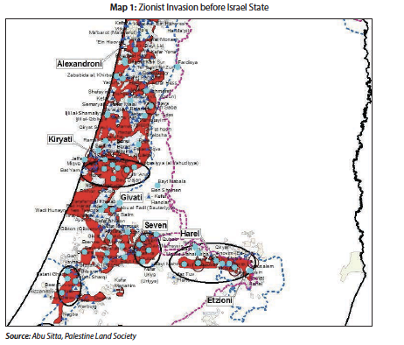
Invasjon av Palestina Plan D April 1948
April 1948: 120,000 soldiers attacked 220 Palestinian towns and villages.
Plan D created half of all Palestinian refugees before the establishment of the state of Israel, before the end of the British mandate, or before Arab soldiers came to Palestine.
By May 15, 220 villages were ethnically cleansed, and the Zionists took over 3,500 sq km (mostly arable land)
Major cities were besieged and water and supplies were cut

Slide 42
Abusitta
356 war crimes committed by Israel between 1947 and 1953, including 156 massacres and killings of civilians.
A total of 530 towns and villages were ethnically cleansed
900,000 Palestinians were rendered stateless

Slide 43
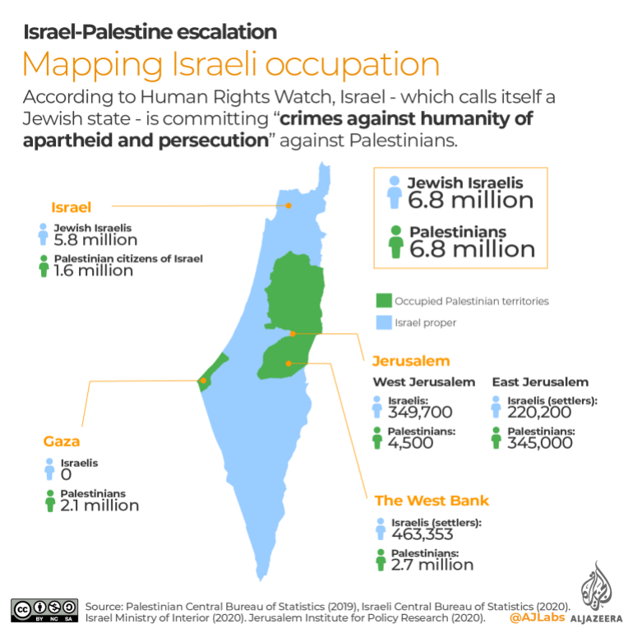

Slide 44
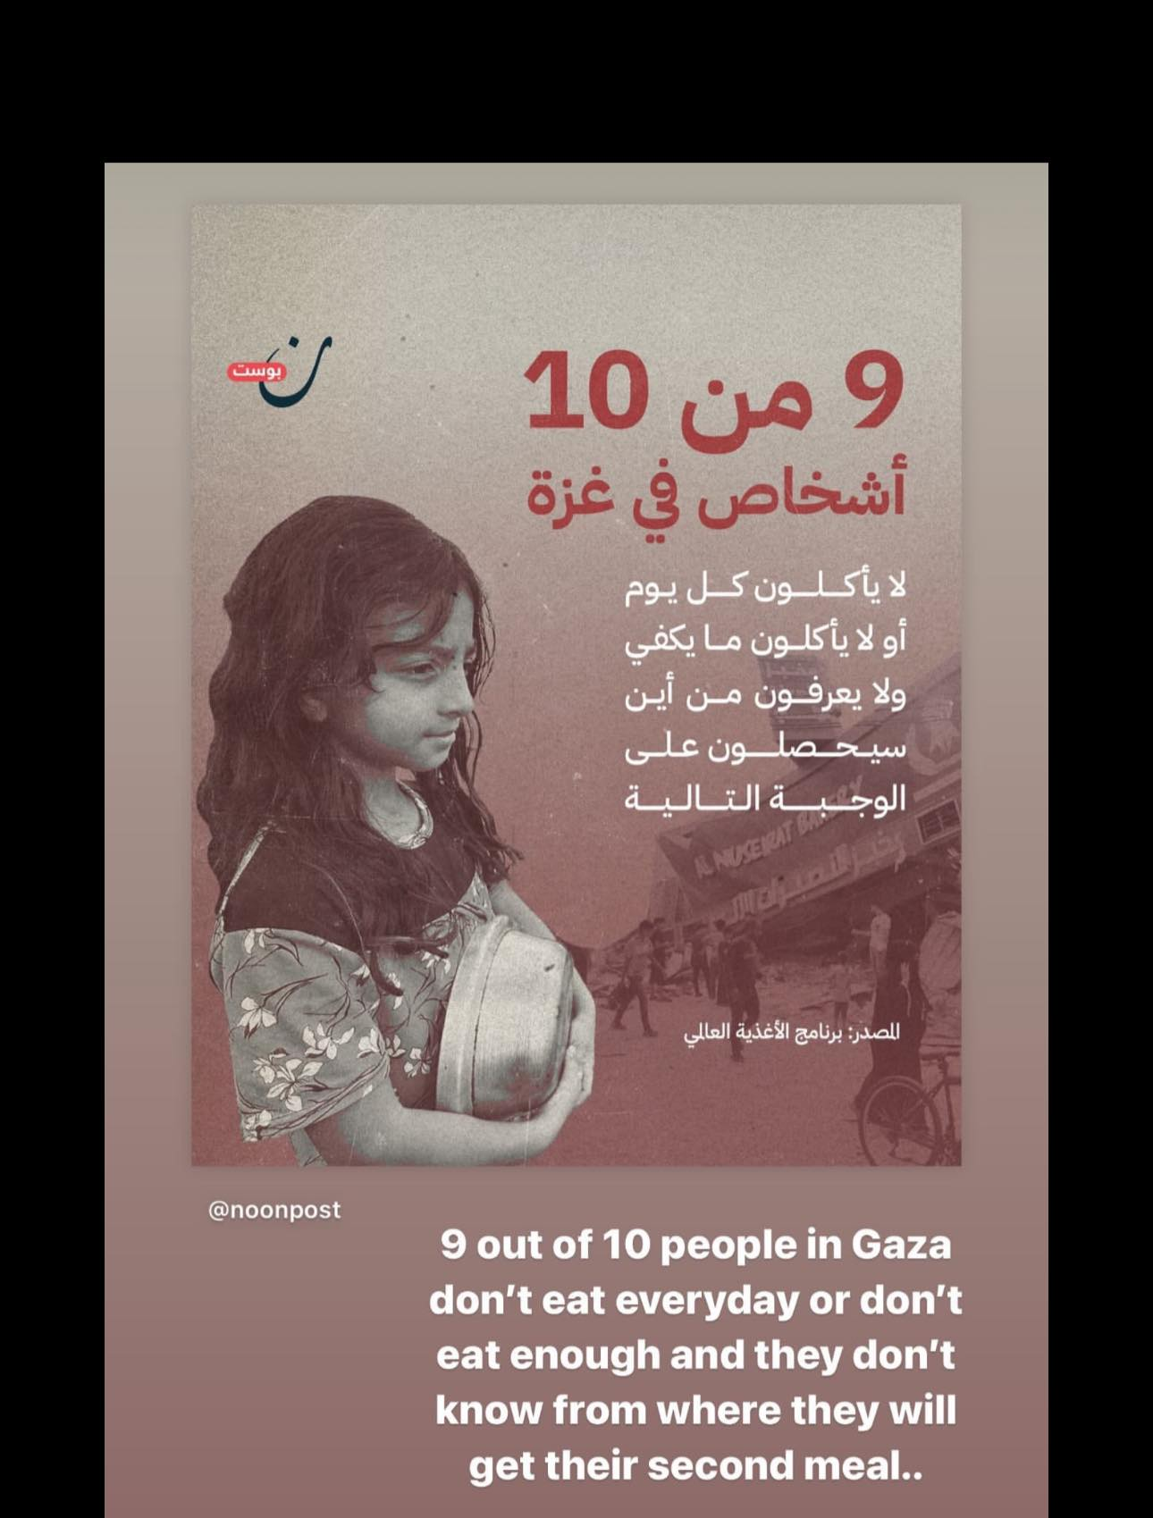
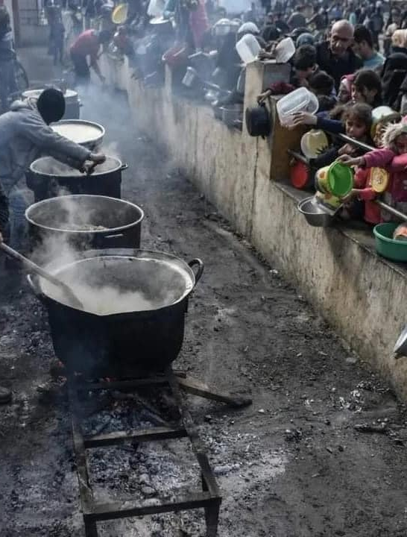
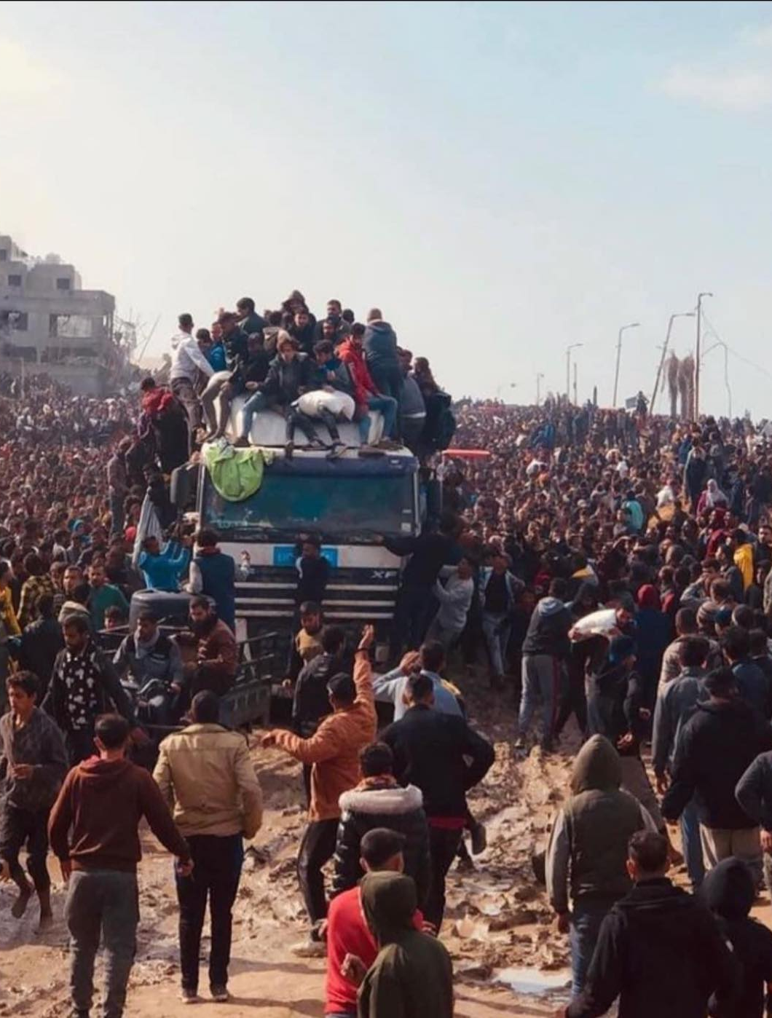
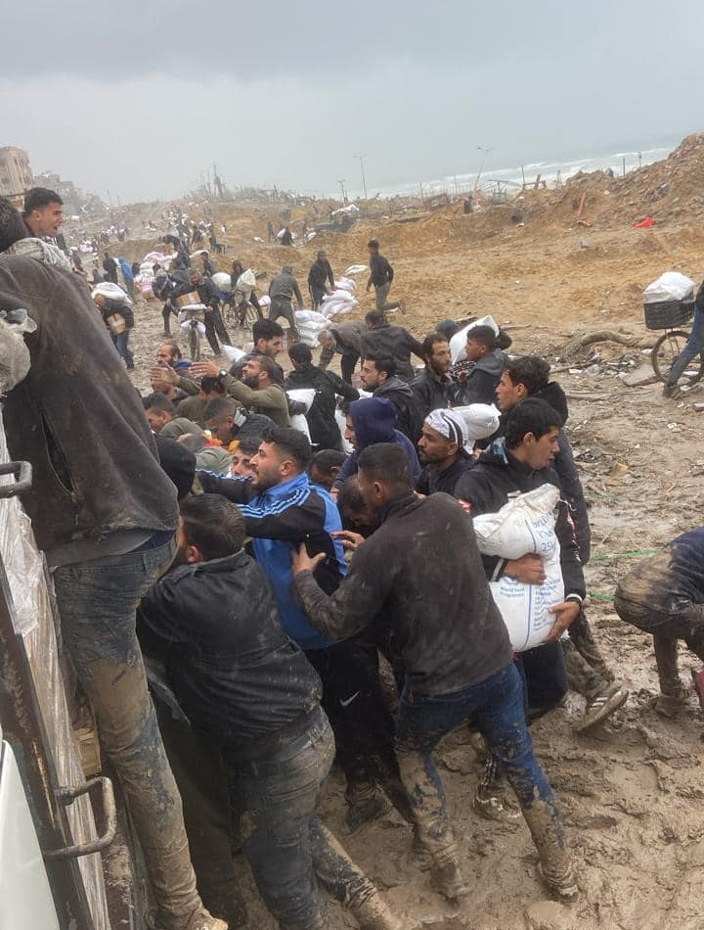
Genocide and Ethnic cleansing of Gaza

Slide 45
Trumps plan: the core strategy of the Zionist ideology
Nothing new about this plan, it is the core strategy of the Zionist ideology
Theodore Herzl, the Zionist movement’s founder. On 12 June 1895, he wrote in his diary, “We shall try to spirit the penniless population across the border by procuring employment for it in the transit countries, while denying it any employment in our own country.”

Slide 46
Trumps plan: the core strategy of the Zionist ideology
Yosef Weitz, director of the Settlement Department of the Jewish National Fund (JNF ), and later head of the Israeli government’s official Transfer Committee, wrote in his diary on 20 December 1940:
  Between ourselves it must be clear that there is no room for both people together in this country…. We shall not achieve our goal of being an independent people with the Arabs in this small country. The only solution is Palestine, at least Western Palestine [west of the Jordan River] without Arabs…. And there is no other way but to transfer the Arabs from here to the neighbouring countries; to transfer all of them; not one village, not one tribe should be left.

Slide 47
Greater Israel from the perspective of their colonial God
The Israel project will not stop until it takes over the land and force all the people who live between the Nile and Euphorate out.
The Palestinian people are only the beginning, others will follow one by one
This project still has full support in many parts of the world specially in the USA
On the same day the Lord made
A covenant with Abraham, saying:
To your descendants I have given this Land, from the river of Egypt to to the Great river, the River of Euphrates”
Genesis 15:18

Slide 48
Israel was never about Jewish Libration
Maxime Rodinson, Israel: A Colonial-Settler State? (New York: Monad Press, 1973), PP40:
It was evident that the early Zionist leaders did not see their project as a Jewish liberation movement; it was, for all practical purposes, a “Jewish colonial settlement in the Orient”
Acknowledging that Israel is a colonial entity that must be be replaced by one single state for all its citizens

Slide 49
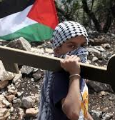
Decolonization
Decolonization to undo the injustices committed against Palestine’s Indigenous people.
  Acknowledging that we are all governed by a system that was not established to end colonialism after the Second World War, but rather to replace the colonial system with another that continues the theft of resources, hegemony, and oppression.
  Support the Palestinian Narratives, it is not complicated or difficult.
  Please stop advocating the 2-state solution. This will never happen. It is a continuation of the colonial-settler project.
  Stop applying moral/legal values that are based on the colonizer view of right and wrong
  The Palestinians fight for their freedom , and they are entitled to do so, by the means they themselves find fit.

Slide 50
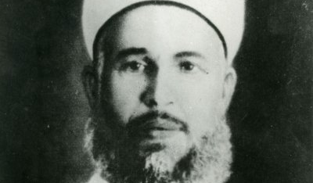
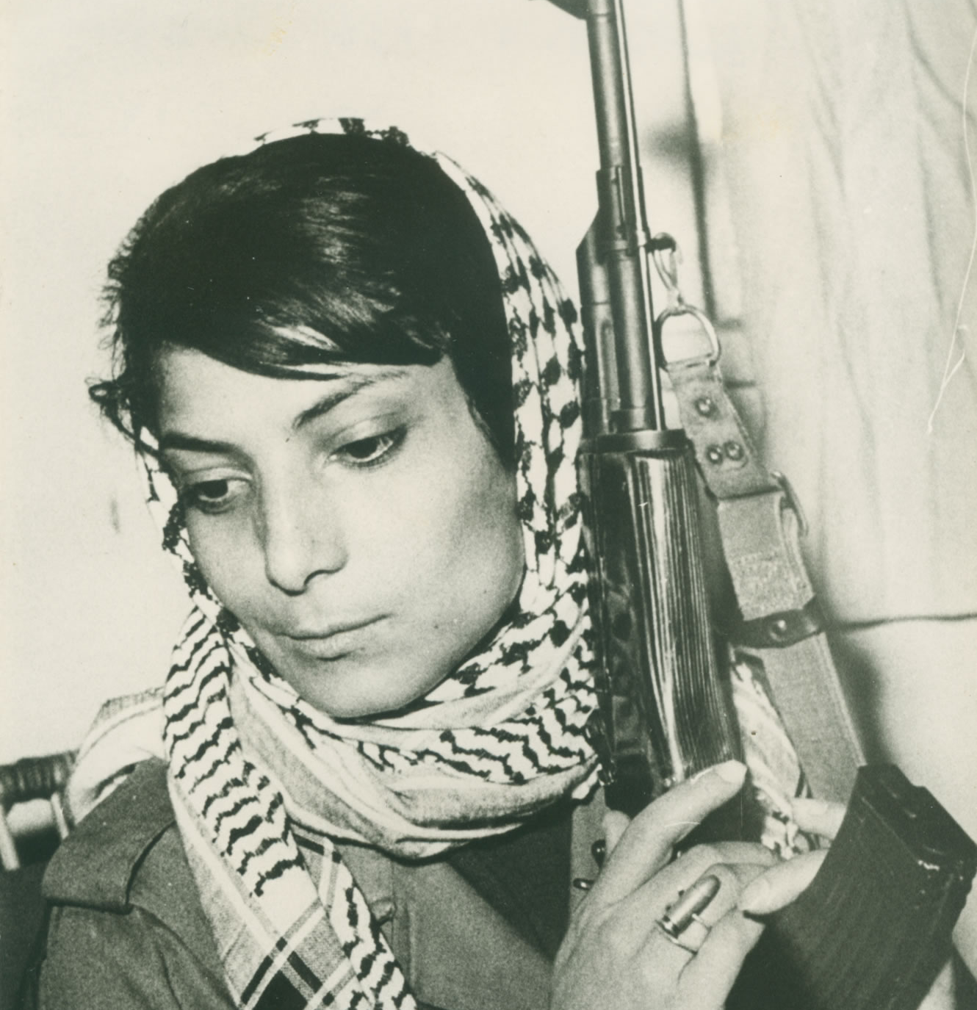

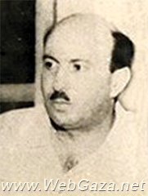

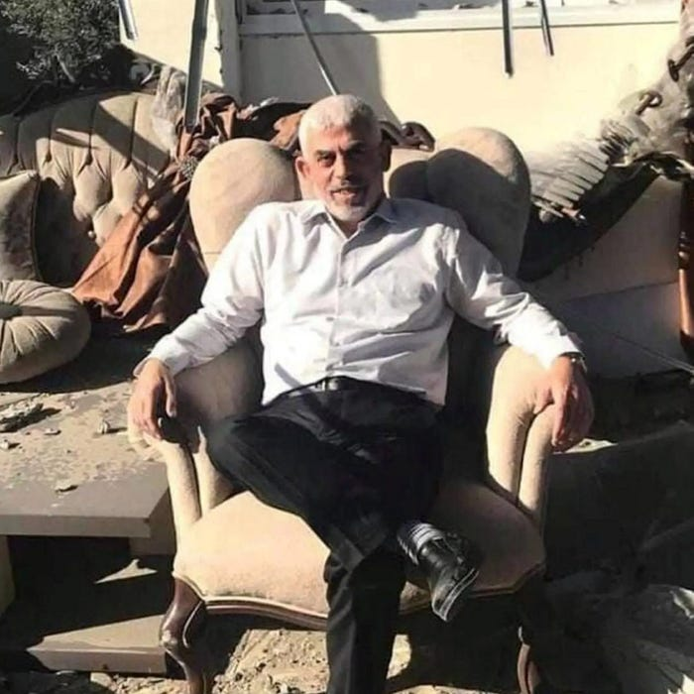
Sumud

